Slide 1
程式設計實習(一)

Slide 2
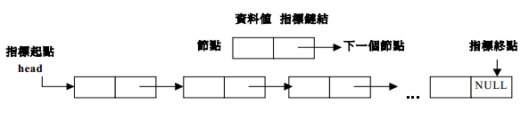
linked list
有次序排列之資料稱為串列(list)。
鏈結串列(linked list)各元素在記憶體之位置是不連續、隨機的。它是由動態記憶體分配節點串接而成。陣列則為一個連續之記憶體結構。

Slide 3
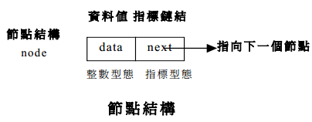
linked list
struct node{
int data;
struct node *next;
};

Slide 4
linked list
int main()
{
node *head = new node;
node *ptr = new node;
node *previous = new node;
…
head->data = 10;
ptr->data = 20;
head->next = ptr;
…
delete ptr;
}
ptr
head
10
20
data next
data next

Slide 5
linked list
加入於串列的前端
head
NULL
ptr
ptr=new node;
ptr->next=head;
head=ptr;

Slide 6
linked list
加入於串列的尾端
head
NULL
temp
ptr
null
ptr=new node;
ptr->next=NULL;
temp=head;
while(temp->next!=NULL)
temp=temp->link;
temp->next=ptr;

Slide 7
linked list
加入在串列某一特定節點(add節點)的後面
temp
head
NULL
ptr
ptr=new node;
ptr->next=temp->next;
temp->next=ptr;

Slide 8
linked list
刪除串列前端的節點
head
head
NULL
ptr
ptr=head;
head=head->next;
delete ptr;

Slide 9
linked list
刪除串列的最後節點
previous
head
NULL
NULL
ptr
ptr = head;
while(ptr->next!=NULL)
{
previous=ptr;
ptr=ptr->next;
}
previous->next=NULL;
delete ptr;

Slide 10
linked list
刪除某一特定的節點
previous
ptr
ptr
NULL
previous->next=ptr->next;
delete ptr;

Slide 11
Hw 9
Insert function
User can insert a new data.
(No. , name , sex and age)
Print function
Print all data of user insert.

Slide 12
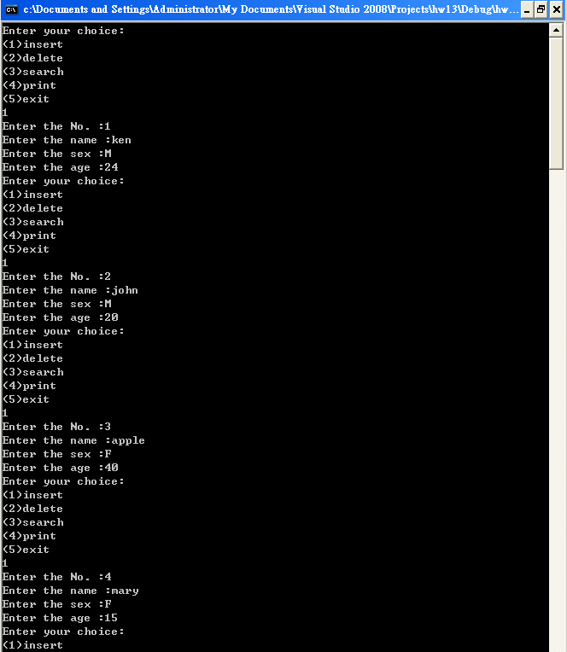
Hw 9

Slide 13
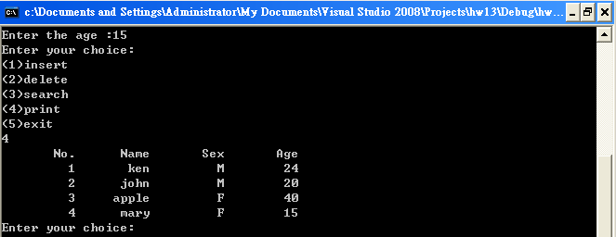
Hw 9

Slide 14
Hw 9
Search function
User can enter the name that he want to search.
Delete function
User can enter the name that he want to delete.

Slide 15
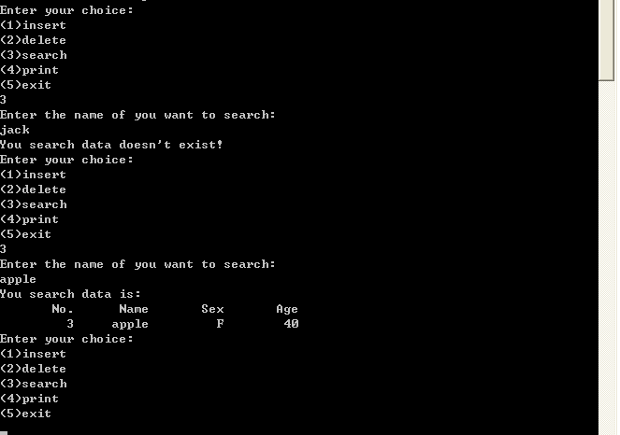
Hw 9

Slide 16
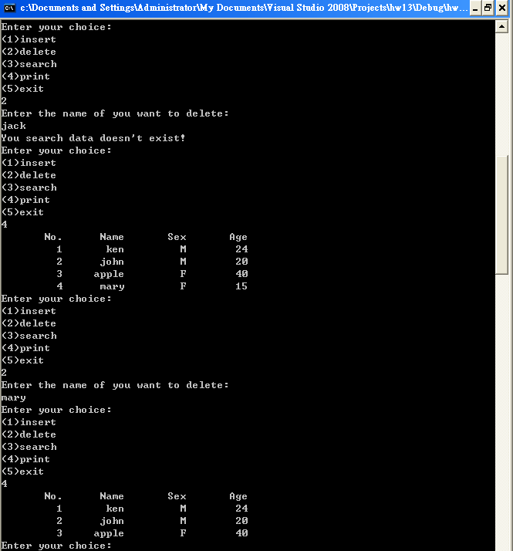
Hw 9

Slide 17
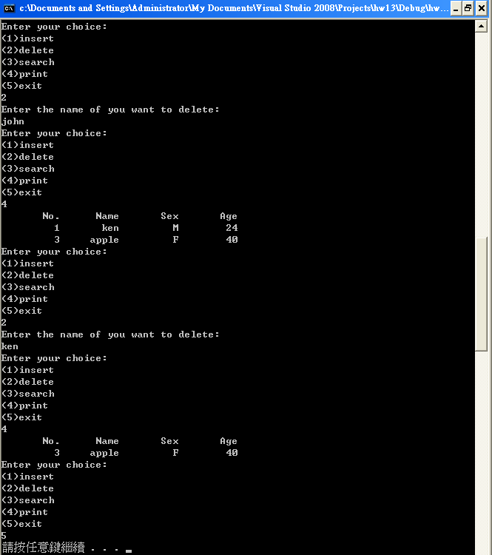
Hw 9

